Slide 1

Robust Car Modification System using AI
Department of Computer Science
COMSATS University Islamabad, Abbottabad Campus
FATIMA AFTAB FA21-BSE-088
BASIT IQBAL FA21-BSE-050
SYED SHAH HUSSAIN BADSHAH FA21-BSE-172
DR AHMED SAEED KHATTAK

Slide 2
Agenda of the Presentation
Introduction
Scope
Functional Requirements
Non-Functional Requirements
User Goals
Use cases
Diagrams
Gant Chart (Schedule)
Details of 1st iteration (30%)
Details of 2nd Iteration (60%)

Slide 3
Brief Introduction
Web-based tool for modification centers
Realistic previews of vehicle customizations
AI-driven detection for accurate overlays
Exterior mods: rims, paint, spoilers
Enhances customer engagement and confidence

Slide 4
Scope (What to do)
A web-based application for car modification centers that offers high-quality, realistic previews.
Part detection and segmentation for accurate modification overlays on vehicle images.
A wide customization catalog including rims, spoilers, paint, headlights, and side mirror shells.
The ability for operators to upload or capture images of vehicles for customization.
Subscription-based access model for flexibility and scalability.
Focus on external modifications with realistic previews and save options.

Slide 5
Scope (What no to do)
No Real-Time Video Feed Modifications
Exclude Interior Modifications
No High-End Hardware Requirements
Avoid Standalone Installation
No Custom Modifications Outside Catalog
No Complex 3D Modeling

Slide 6
Functional Requirements
FR-001 - Admin Registration
FR-002 - Admin Login
FR-003 - Operator Registration (add operator by admin)
FR-004 - Operator Login
FR-005 - Login Credential Validation
FR-006 - Secure Credential Storage
FR-007 - Upload Image
FR-008 - Capture Image
FR-009 - Image Preview
FR-010 - AI-Driven Part Detection
FR-011 - Overlay Custom Parts
FR-012 - Car Parts Catalog (Inventory)
FR-013 - Manage Catalog
FR-014 - Save Customizations
FR-015 - Retrieve Saved Customizations (View samples)
FR-016 - User Account Management
FR-017 - API Integration for AI Models

Slide 7
Non-Functional Requirements
1. Usability
Easy Image Upload & Preview
User-Friendly Interface
2. Performance
Image Processing Speed
API Response Time
3. Scalability
Support for New Features and Modules
Horizontal Scaling with Minimal Downtime
4. Maintainability
Zero-Downtime Updates and Bug Fixes
Comprehensive Developer Documentation
Modular and Replaceable Components

Slide 8
Continue
5. Accuracy
High Accuracy in Part Detection and Segmentation
Regular Testing and Validation
6. Modularity
Modular Architecture Design
Well-Defined Interfaces for Integration
Easy Addition of New Features
Independent Module Testing
7. Flexibility
Adding New Car Models and Parts
Extensible for Future Modifications
8. Effectiveness
Quick Customization Process
Realistic AI-Powered Previews

Slide 9
Use Cases
Login
Logout
Register
Manage Profile
Manage Inventory
Manage Operators
Upload Image
Capture Image
Apply Modifications
View Samples
Manage Admins
View Analytics

Slide 10
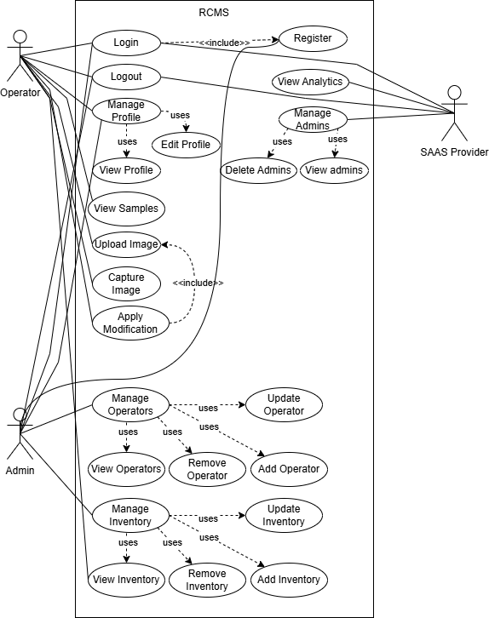
Use Case Diagram

Slide 11
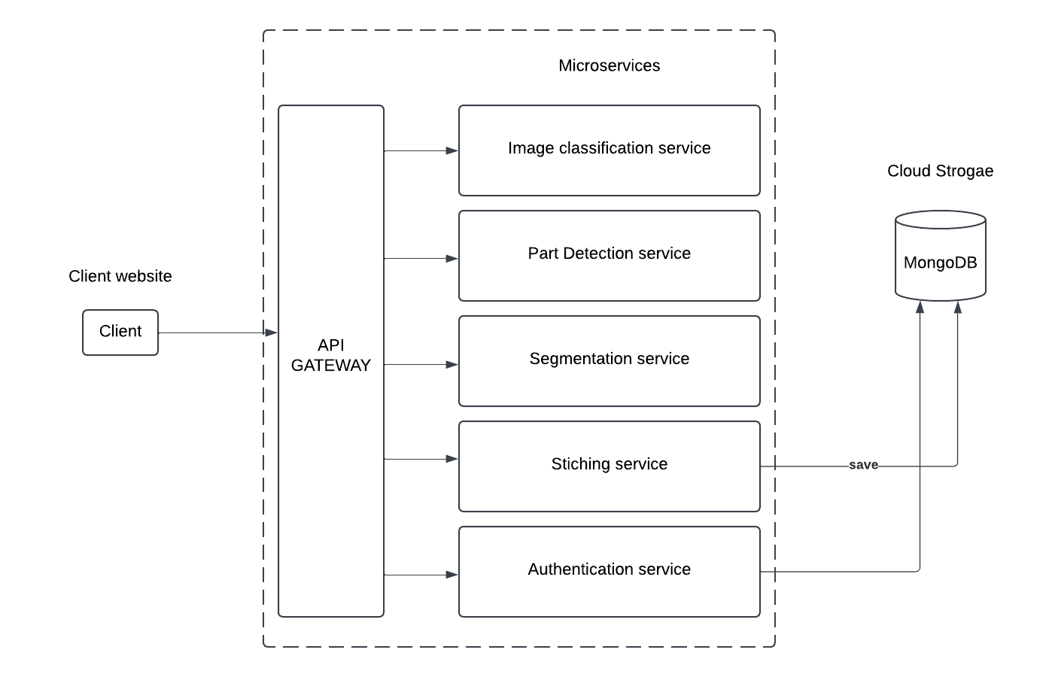
Architecture Diagram

Slide 12
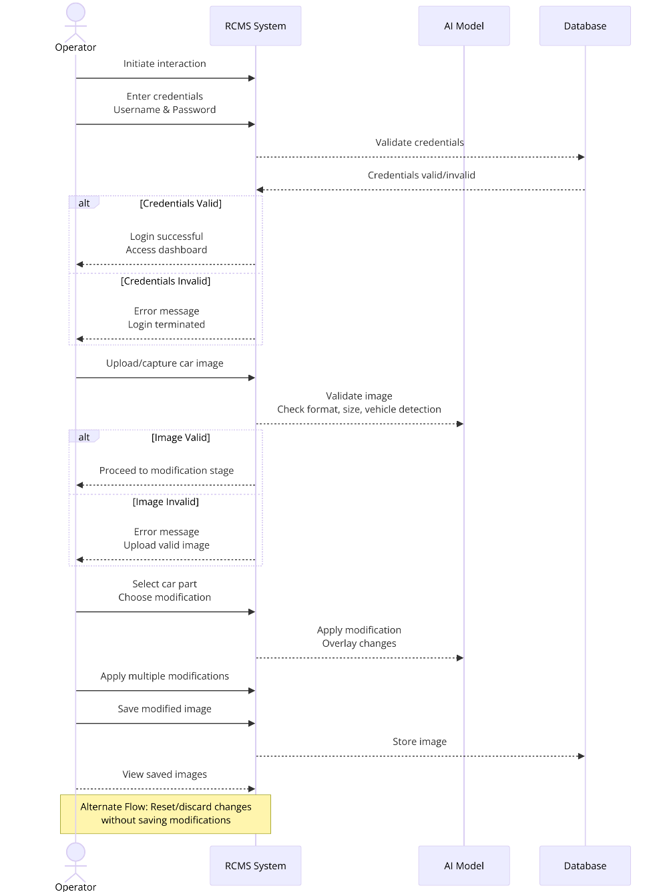
System Sequence Diagram (Operator)

Slide 13
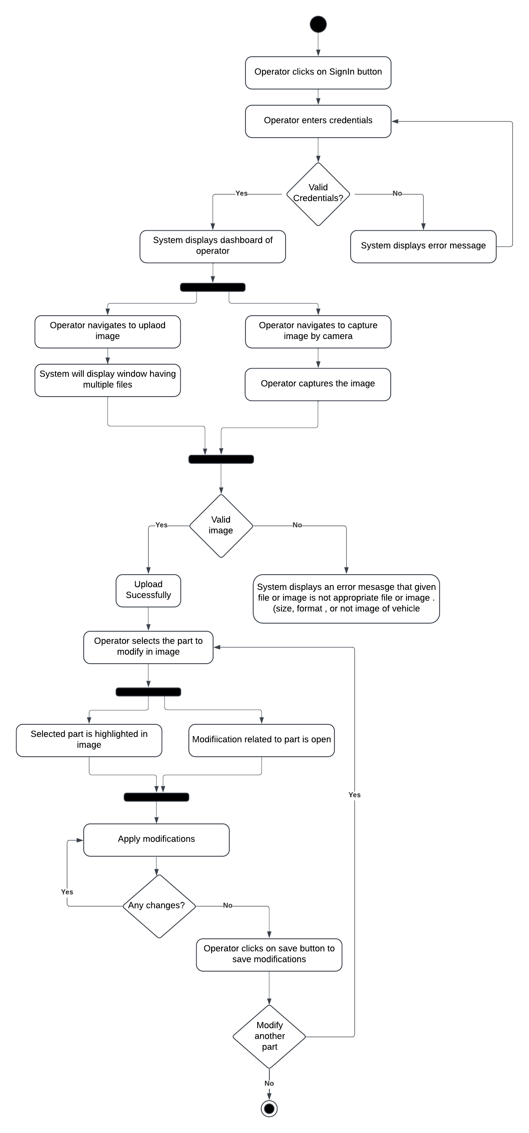
Activity Diagram

Slide 14
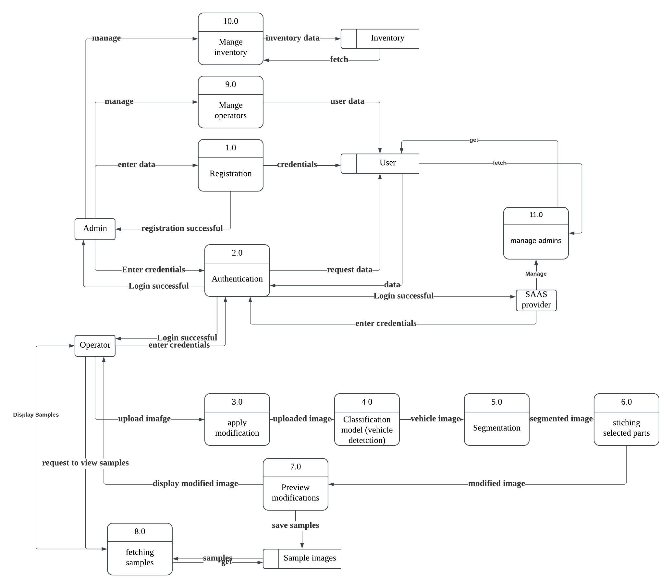
DFD

Slide 15
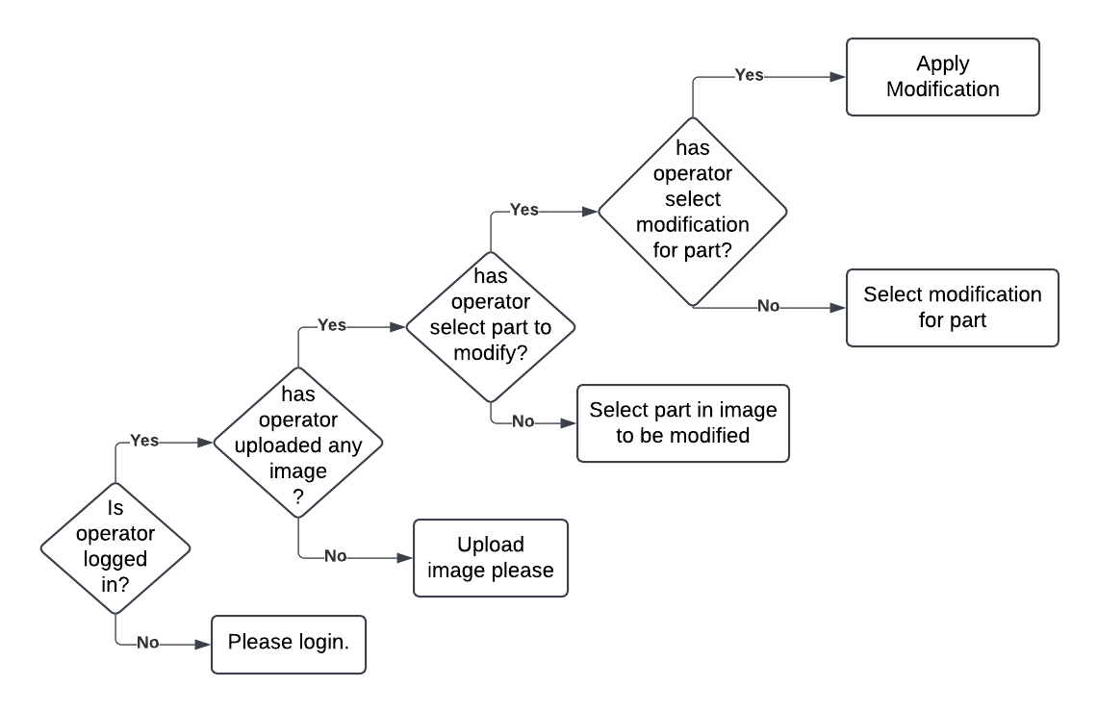
Decision Tree (Apply Modification)

Slide 16
Data Set Gathering
1st Model
Non_cars: 1570
Cars:1230
2nd Model [imbalanced data set]
Non_cars: 1570
Cars: 3235
3rd Model [Accuracy 97% - 98%]
Non_cars: 3235 (random images: 1165, people:500, non_cars from previous dataset)
Cars: 3235

Slide 17
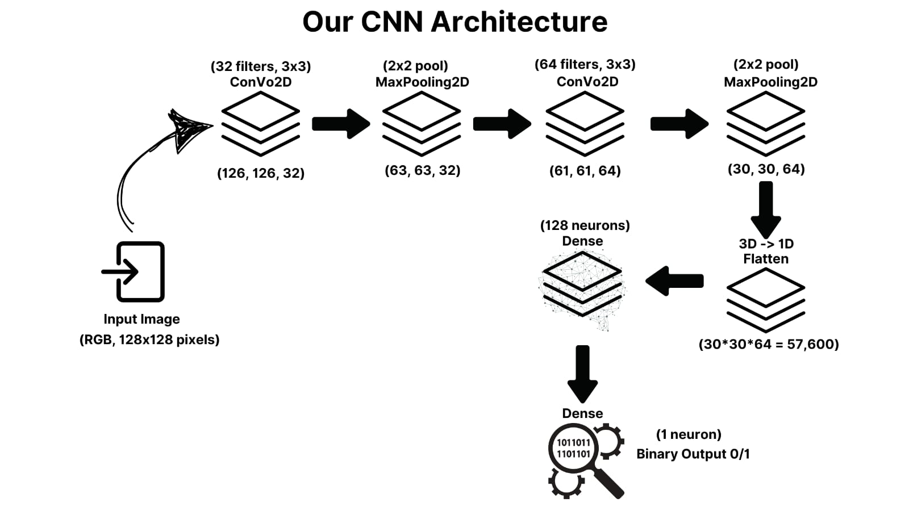
CNN ARCHITECTURE

Slide 18
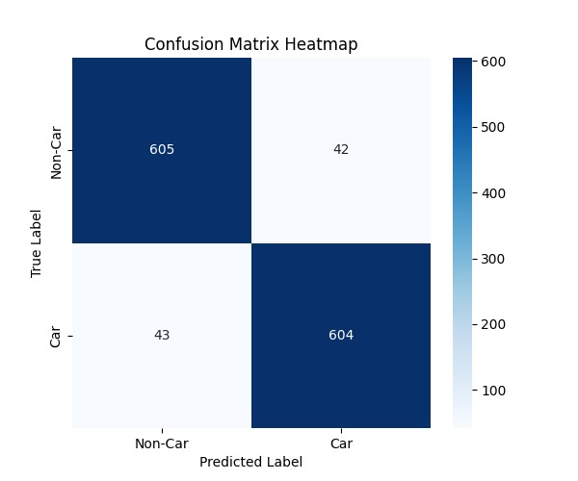

Confusion Matrix

Slide 19
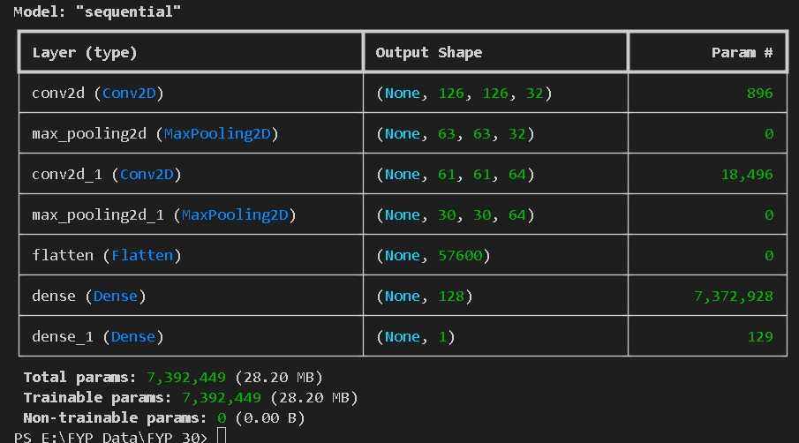
Parameters

Slide 20
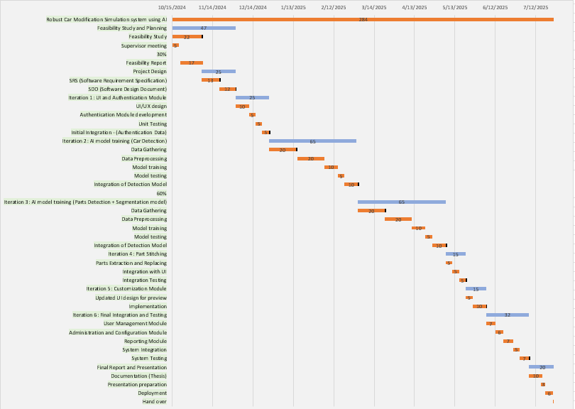
Schedule

Slide 21
Details of 1st Iteration (30%)
SRS
SDD
Authentication
Frontend
AI model for vehicle detection

Slide 22
Details of 2nd Iteration (60%)
Car Parts Detection using ML
Segmentation of car Parts
Parts Extraction
Backend setup
Connecting Frontend to Backend
Inventory Management Module

